Slide 1
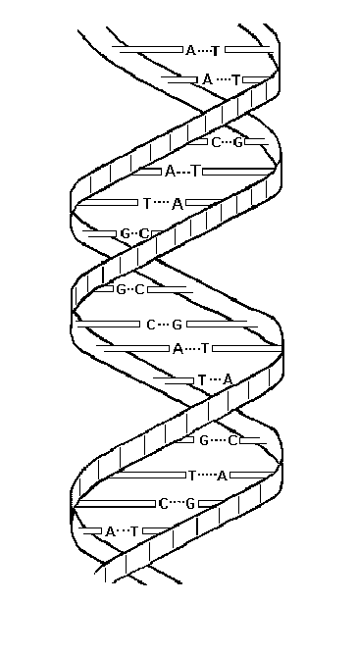
SEPT / NOV 2024: EXAM PREPARATION – PAPER 2
Life Sciences

Slide 2
Life Sciences
How to Prepare for P2
FOLLOW THE EXAM GUIDELINES – EVOLUTION (54 marks)
REVISE EACH TOPIC MENTIONED BELOW
TEST YOURSELF BY DOING PAST PAPER QUESTIONS
MARK YOUR ANSWERS – USE MARKING GUIDELINES
BE SPECIFIC IN THE WAY YOU ANSWER QUESTIONS
SEE HOW MARKS ARE ALLOCATED
FORM SUPPORT GROUPS
GET A REASON WHY YOU WANT TO DO WELL

Slide 3
FORMAT and MARK ALLOCATION
DNA – Code of Life: (27)
Meiosis: (21)
Genetics and Inheritance: (48) Evolution: (54)
TOTAL: [150]

Slide 4
FORMAT and MARK ALLOCATION

Slide 5
DNA: The Code of Life (27 Marks)
How do the following concepts relate?
Cell
Nucleus
Chromosomes
Chromatids
DNA
Nucleotides
Genes

Slide 6
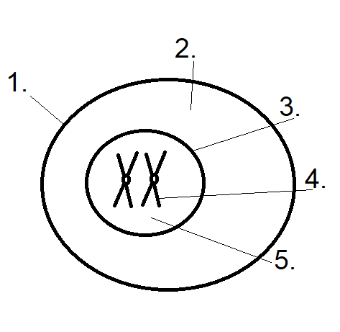
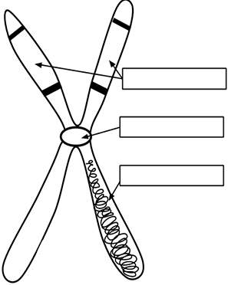
DNA: The Code of Lifees
Cell Membrane
Cytoplasm
Nucleus
Chromosome
Chromatids
Centromere
DNA

Slide 7
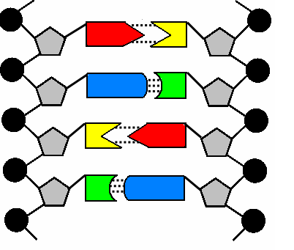
es
DNA Structure
Nucleotide

Slide 8
QUESTIONS ON DNA

Slide 9
QUESTIONS ON DNA & RNA

Slide 10
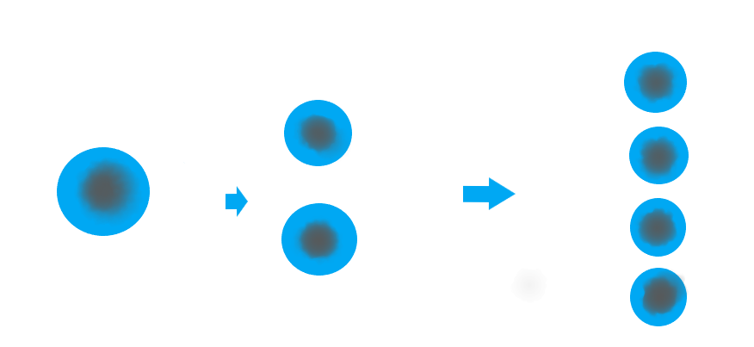
DNA: The Code of Life
DNA REPLICATION
Why?
When?
Same DNA

Slide 11
Describe DNA Replication

Slide 12
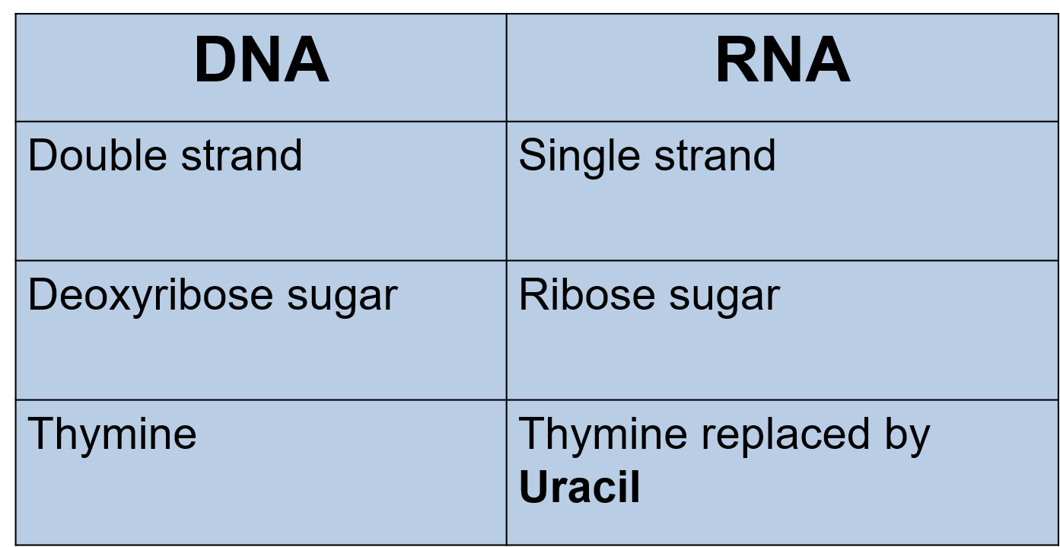
DNA: THE CODE OF LIFE

Slide 13
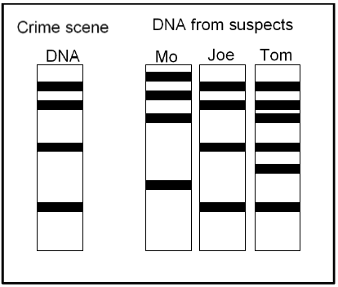
DNA: THE CODE OF LIFE
DNA PROFILE – Uses?

Slide 14
Protein Synthesis

Slide 15
Protein Synthesis

Slide 16
Protein Synthesis

Slide 17
Protein Synthesis

Slide 18
Meiosis (21 Marks)
Key Concepts
Compare Meiosis to Mitosis
Autosomes and Gonosomes
Chromosome numbers
Importance of Meiosis
Abnormal Meiosis
8 Phases of Meiosis – Identify, Label and Describe
How Meiosis Contributes to Variation

Slide 19
Meiosis: Chromosome Numbers

Slide 20
Meiosis: Chromosome Numbers - Answers

Slide 21
Importance of Meiosis

Slide 22
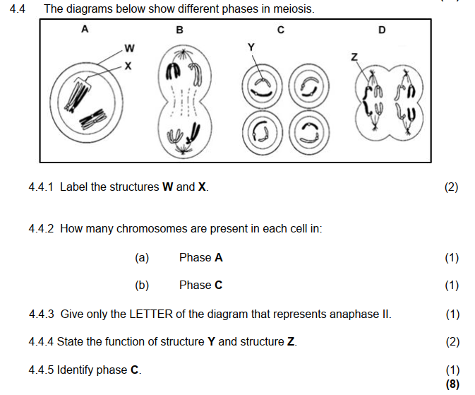
Phases of Meiosis

Slide 23
Phases of Meiosis - Answers

Slide 24
Meiosis: Crossing Over in Prophase I

Slide 25
Crossing Over: Answers

Slide 26
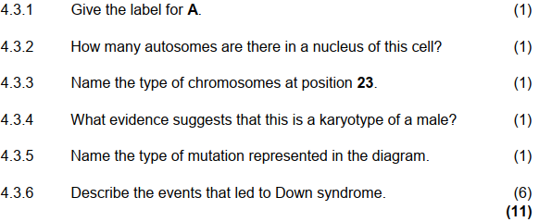
Abnormal Meiosis: Down Syndrome

Slide 27
What Leads to Down Syndrome?

Slide 28
Down Syndrome - Answers

Slide 29
Genetics and Inheritance (48Marks)
Key Concepts
Terminology
Mendel’s Law of (1) Dominance & (2) Segregation
Determination of Gender
Types of Dominance
Blood Groups
Gender Related Problems
Dihybrid Crosses
Pedigree Diagrams
Mutations
Genetic Engineering

Slide 30
Genetics: Terminology

Slide 31
Genetics: Terminology

Slide 32
2 Laws of Mendel

Slide 33
Determination of Gender

Slide 34
Genetics: Types of Dominance – Complete Dominance

Slide 35
Types of Dominance – Incomplete Dominance There is No Dominance – Use Capital Letters Only! Eg Red Rose x White Rose gives Pink in F1
Answer: D

Slide 36
Types of Dominance: Co-Dominance Both Features are Expressed in the F1 Phenotype and are Equally Dominant. Use Capital Letters Only!
Eg
P1: Brown Horse x White Horse gives Brown and White Patches in F1
Genotype: BB x WW gives BW in F1

Slide 37
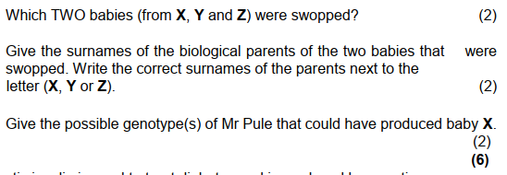
Blood Groups: Between A & B there Is Co-Dominance (Group A x Group B) gives AB

Slide 38
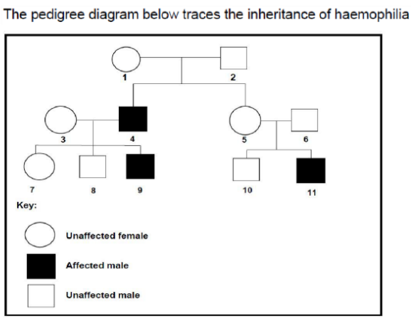
GENDER RELATED PROBLEMS
Haemophilia & Colour-Blindness
Use X and Y

Slide 39
GENDER RELATED PROBLEMS - Questions

Slide 40
Dihybrid Crosses

Slide 41
Dihybrid Answers

Slide 42
Mutations

Slide 43
Genetic Engineering
GMO’s
Stem Cells
Cloning – Understand why and how it’s done
What are GMO’s? Any benefits or problems?
Use of Stem Cells – How?

Slide 44
Genetic Engineering

Slide 45
Genetic Engineering - Questions

Slide 46
Genetic Engineering - Answers

Slide 47
Genetic Engineering - Answers

Slide 48
Mitochondrial DNA
What is Mt-DNA
The Value of Mutations in Mt-DNA to trace Maternal Ancestry

Slide 49
Paternity Testing
Blood Groups
vs
DNA Profiling – More Accurate, Why?

Slide 50
Be Successful in Life Sciences
Step 1: Follow the Exam Guidelines
Step 2: Revise the Material
Step 3: Test Yourself by Using Past Papers
Best Wishes with Paper 2!

